Slide 1

SATELLITE IMAGE DEHAZING USIN DCP ALGORITHM AND COMPARISON WITH CNN ALGORITHM
by
Nazreen J
Roll No. 204G1A3325
Mohammed Abuzarh S
Roll No. 204G1A3323
Sushma P
Roll No. 204G1A3357
Pavan Kumar R T
Roll No. 204G1A3330
Under the guidance of
Mr. B.Sreedhar M.Tech.,(Ph.D)
Assistant Professor
Assistant Professor
Department of Computer Science and Engineering (AI&ML)
Srinivasa Ramanujan Institute of Technology
Autonomous
Rotarypuram Village, B K Samudram Mandal, Ananthapuramu – 515701.
2022-2023

Slide 2

Contents
Abstract
Objectives
Introduction
Literature Survey
Existing System
Proposed System
Planning and Design
Implementation
Paper Publication Proof
References

Slide 3
Abstract
In recent years, the quality of satellite images has been significantly affected by atmospheric haze, which poses challenges for accurate interpretation and analysis. As a response to this issue, our project aims to develop effective dehazing algorithms tailored specifically for satellite imagery.
This project focuses on improving the quality of satellite images through dehazing techniques and comparing different dehazing algorithms. It addresses the issue of image degradation due to atmospheric elements like haze using the Dark Channel Prior (DCP) algorithm and compares it with the Convolutional Neural Network algorithm using deep learning.
The goal is to enhance environmental monitoring efforts by improving the reliability of satellite-based data. This project aims to contribute to the field of computer vision and environmental science by enhancing the clarity of satellite images for various applications, including land use monitoring, disaster management, and urban planning.
.

Slide 4
Objectives
Research Objective1: To obtain a dehazed image from a hazed .using Dark Channel Prior Algorithm (DCP) and Convolutional Neural Network (CNN).
Research Objective2: The project aims to conduct a thorough comparative analysis between the DCP and CNN Algorithms.

Slide 5
Introduction
The project aims to enhance satellite image quality by developing and comparing dehazing algorithms, primarily focusing on the Dark Channel Prior (DCP) and CNN techniques. In DCP , Airlight estimation, crucial for identifying haze, is a key component of the algorithm. By computing transmission maps based on estimated airlight and pixel intensities, haze can be effectively removed and image clarity improved.
The project also compares the DCP algorithm with CNN-based dehazing techniques, evaluating factors such as visual quality, computational complexity, and adaptability to different atmospheric conditions. Through this comparative analysis on diverse satellite images, the project seeks to provide valuable insights into the effectiveness of various dehazing techniques in real-world scenarios.
Additionally, it aims to identify areas for improvement in existing algorithms, fostering further research and innovation in satellite image processing. Ultimately, by advancing dehazing algorithms and comparing their performance, the project contributes to enhancing environmental monitoring and analysis capabilities in satellite imagery.

Slide 6
Literature survey
1.Zhang and co-authors (2020) proposed an innovative satellite image dehazing method based on the Dark Channel Prior (DCP). Their approach utilizes the dark channel as a key feature to estimate and remove atmospheric haze from satellite images, demonstrating improved performance in enhancing visibility and revealing clearer details in hazy satellite scenes.
2. Liu and collaborators (2021) introduced an unsupervised satellite image dehazing technique that combines the DCP with CycleGAN. Their method not only estimates and removes haze using the dark channel but also leverages CycleGAN for unsupervised learning, contributing to the generation of high-quality, dehazed satellite imagery.

Slide 7
Literature survey
3. Huang and the research team (2022) proposed a novel approach to satellite image dehazing by fusing atmospheric light estimation with the DCP. Their method enhances the accuracy of dehazing by incorporating atmospheric light information, contributing to improved visibility and contrast in satellite imagery. The fusion of these components demonstrates significant advancements in addressing hazy conditions.
4. Chen et al. (2018) introduced a satellite image dehazing method based on image fusion and wavelet transform. They combine multiple hazy images captured under different atmospheric conditions and utilize wavelet transform for dehazing.

Slide 8
Existing System
The Dark Channel Prior (DCP) algorithm, introduced by Kaiming He et al., is a method for removing haze or fog from images. It operates by first calculating the dark channel, where each pixel represents the minimum intensity value within a local patch across all colour channels.
Next, the atmospheric light, which indicates haze-free regions, is estimated from the dark channel. Using this information, a transmission map is computed, representing the proportion of light that travels from the scene to the camera.
Finally, the haze-free image is reconstructed using the estimated transmission map and atmospheric light, effectively removing the haze.
The DCP algorithm is widely used due to its simplicity and effectiveness in restoring visibility in outdoor scenes affected by haze.

Slide 9
Existing System
Disadvantages:
Artifact Generation: In some cases, DCP algorithm can produce Artifacts in the dehazed images, especially in regions with complex structures or textures
Atmospheric Light Estimation Errors: In scenes with complex lighting conditions or multiple light sources the atmospheric light estimated by DCP may not accurately represent the true atmospheric conditions, leading to errors in the dehazing process.

Slide 10
Proposed System
The proposed work aims to enhance satellite image dehazing by integrating guided filtering and radiance recovery techniques into the Dark Channel Prior (DCP) algorithm. The enhanced Dark Channel Prior (DCP) algorithm, incorporating guided filtering and radiance recovery, follows a systematic workflow to remove haze from images.
Initially, the algorithm computes the dark channel, identifying regions likely affected by haze. Then, it estimates the atmospheric light, refining this estimation with radiance recovery techniques to better account for complex lighting conditions. Subsequently, the transmission map, representing haze density, is calculated and refined using guided filtering to ensure spatial coherence and minimize artifacts.
With the refined transmission map and atmospheric light, the algorithm reconstructs a haze-free image, employing guided filtering to maintain smoothness and coherence.
Finally, post-processing steps may be applied to further enhance the dehazed image's quality. This integrated approach significantly improves haze removal accuracy and produces high-quality, visually appealing results, particularly in challenging scenarios with varying haze densities and complex lighting environments.

Slide 11
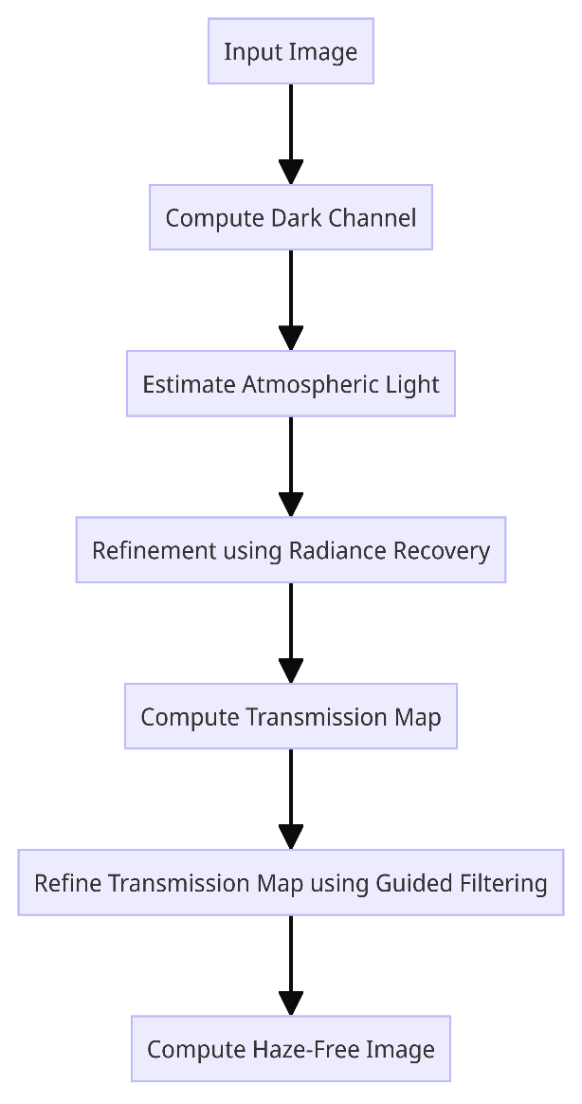
Proposed System
Fig: Dark Channel Prior Algorithm

Slide 12
Proposed System
In addition to enhancing the Dark Channel Prior (DCP) algorithm with guided filtering and radiance recovery, We have chosen an alternative approach involves developing a Convolutional Neural Network (CNN) model specifically designed for Satellite image dehazing. This CNN model aims to learn the intricate relationships between hazy and haze-free images, leveraging deep learning techniques to automatically extract features and perform haze removal.
After Dehazing a satellite image with DCP and CNN, It involves comparing the performance of the enhanced DCP algorithm and the CNN model. Through rigorous evaluation and comparison, insights into the strengths and weaknesses of each approach can be gained, guiding future advancements in satellite image dehazing technology.
This comparative analysis will contribute to the field by offering a comprehensive understanding of different dehazing methodologies and their applicability in real-world scenarios,

Slide 13
Planning
Requirement Specification:
Hardware Requirements:
System Processor : Intel I3
Hard Disk : 500 GB
Ram : 4 GB
Software Requirements:
Operating system : Windows OS 8
Coding Language : Python
Software : VSCODE
IDE : GOOGLE COLLAB

Slide 14
Planning
Functional Requirements
A Functional Requirement is a description of the service that the software must offer. It describes a software system or its component. A function is nothing but inputs to the software system, its behaviour, and outputs. It can be a calculation, data manipulation, business process, user interaction, or any other specific functionality which defines what function a system is likely to perform. In software engineering and systems engineering, a Functional Requirement can range from the high-level abstract statement of the sender's necessity to detailed mathematical functional requirement specifications.
Data Collection
Data Pre-Processing
Training and Testing
Modelling

Slide 15
Planning
Time Estimation:
Basically our project is divided into two phases:
Phase-1:Pre-requisites, Planning and Designing
S. No | Activity | Duration
1 | Domain Selection | 1 Week
2 | Literature survey and problem definition | 2 Weeks
3 | Planning and Designing | 3 Weeks
Table : Activities performed in Phase-1

Slide 16
Planning
Phase-2:Developing the model
S. No | Activity | Duration
1 | Data collection and Data pre processing | 1 Week
2 | Developing code | 2Weeks
3 | Building DCP and CNN model | 2 Weeks
4 | Validating and comparing models | 2 Weeks
5 | Building web page and integrating the model | 1 week
Table: Activities Performed in Phase 2

Slide 17
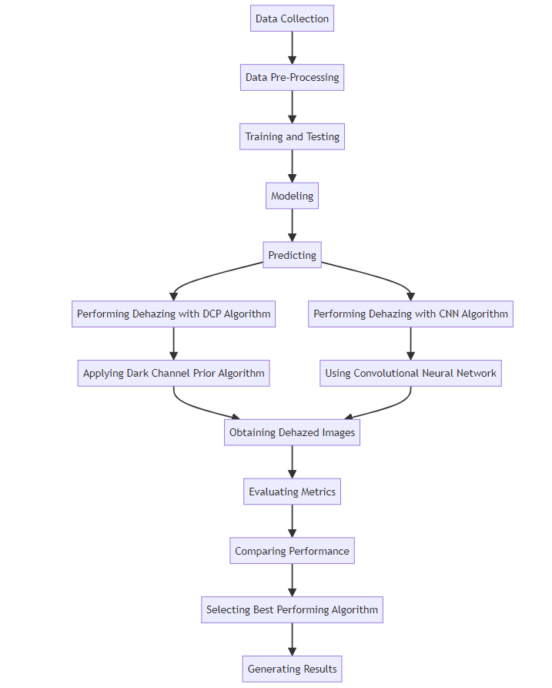
Designing
Fig: System Architecture of proposed model

Slide 18
Implementation
Frontend: web page using HTML,CSS
Backend: developing a model using DCP Algorithm, Convolutional Neural Network ( CNN).
we've adopted two distinct methodologies for satellite image dehazing: Convolutional Neural Network (CNN) and Dark Channel Prior (DCP). The CNN architecture is meticulously crafted with layers for convolution, pooling, and fully connected operations. These layers are meticulously crafted to discern hierarchical features from input images, enabling the model to learn intricate patterns directly from the data. The input shape of the CNN model is tailored to the dimensions of the input images, while the output shape corresponds to the dehazed version of the input image.

Slide 19

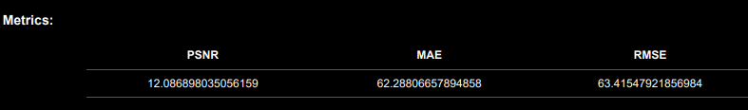
Results
Evaluation of Algorithms:
Evaluates the performance of two different algorithms, including Dark Channel Prior, Convolutional Neural Network (CNN),
Fig. Metrics Of DCP algorithm
Fig. Metrics Of CNN

Slide 20
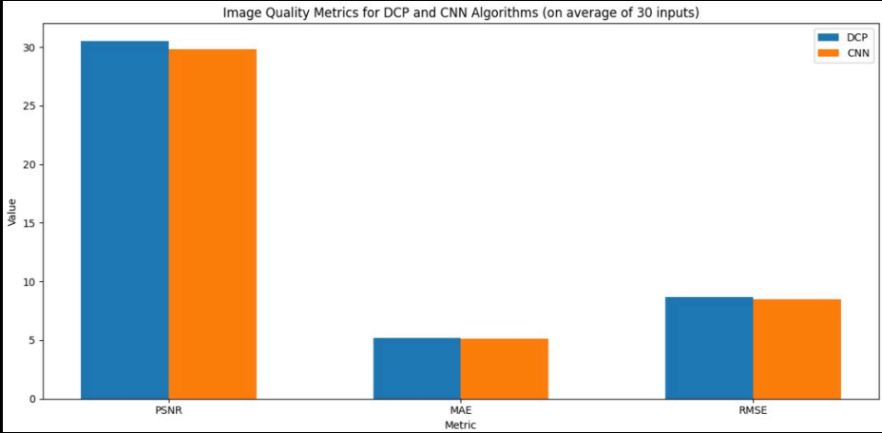
Results
Performance comparison of Model:
After evaluating the performance of the two algorithms, the results can be compared to determine which algorithm performs the best. For instance, the PSNR, MAE, and RMSE.
Comparing algorithms in our project is like comparing different tools to see which one works best for a specific job. It's essential because we want to make sure we're using the most effective method to get the job done. By trying out different algorithms and seeing how they perform, we can figure out which one gives us the most accurate results, runs the fastest, or uses the least amount of resources. This helps us choose the right approach for our project's goals and limitations.

Slide 21
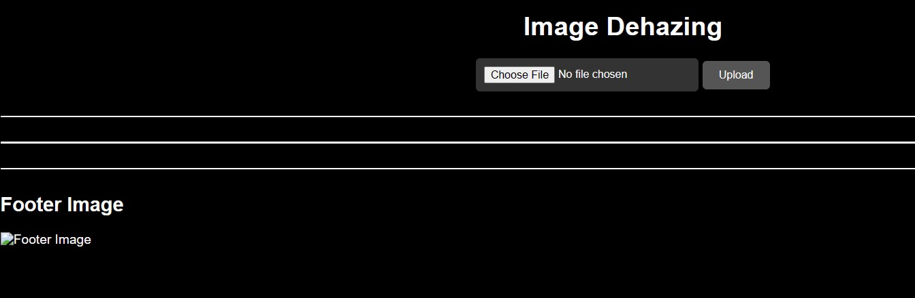
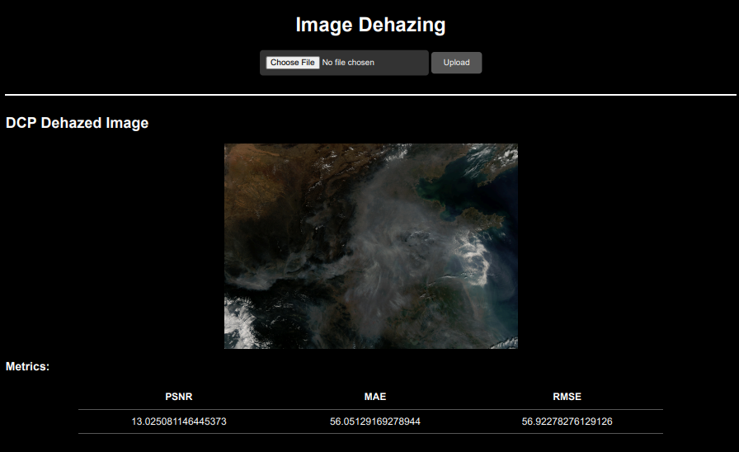
Contd…
Web app results:
Fig:Image Dehazing using web app UI

Slide 22
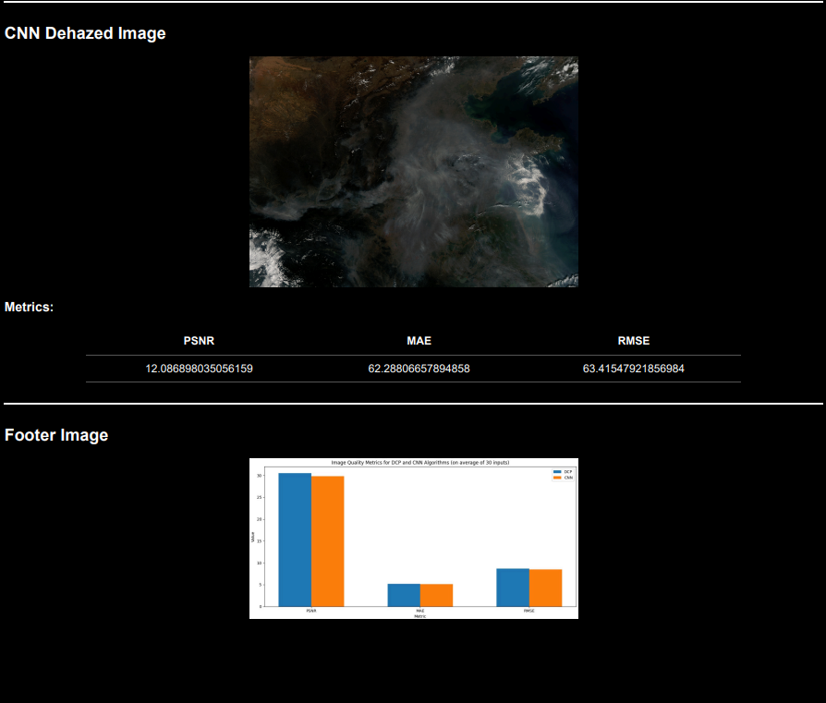
Contd…

Slide 23
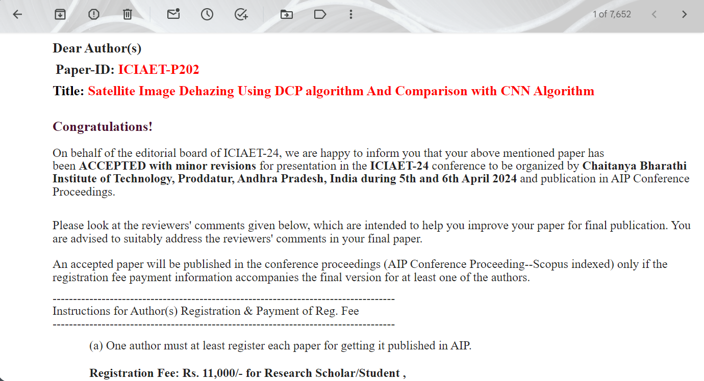
Paper Publication

Slide 24
Conclusion
In conclusion, our comparison between the DCP and CNN algorithms for satellite image dehazing indicates that DCP yields favourable results when compared to CNN. This assertion is based on DCP's ability to achieve a high PSNR (Peak Signal-to-Noise Ratio) value and lower MAE (Mean Absolute Error) and RMSE (Root Mean Square Error) values. These metrics collectively demonstrate DCP's effectiveness in preserving image quality while minimizing the disparity between dehazed images and their clear originals. Therefore, DCP stands as a promising choice for satellite image dehazing tasks, offering both high fidelity and accuracy in atmospheric condition estimation.

Slide 25
References
[1] Zhang, Y., et al. (2023). Innovative satellite image dehazing method based on Dark Channel Prior. Enhances visibility and reveals clearer details in hazy satellite scenes.
[2] Liu, X., et al. (2021). Unsupervised satellite image dehazing combining Dark Channel Prior with CycleGAN. Dual approach for highquality, dehazed satellite imagery.
[3] Huang, Y., et al. (2022). Fusion of atmospheric light estimation with Dark Channel Prior for novel satellite image dehazing. Enhances accuracy in dehazing by incorporating atmospheric light information.
[4] Cheng, L., et al. (2018). Adaptive dark channel prior for satellite image dehazing. Dynamically adjusts the dark channel prior for robust dehazing performance.
[5] Yang, Z., et al. (2019). Fusion strategy combining residual networks with Dark Channel Prior for enhanced dehazing. Superior accuracy in dehazing satellite images.
[6] Gao, Z., et al. (2020). Deep learning-based approach for dehazing satellite images. Leveraging CNNs for precise dehazing.

Slide 26
References
[7] Xu, Z., et al. (2021). Multi-stage approach specifically tailored for dehazed satellite imagery. Achieves enhanced accuracy through successive stages of dehazing, feature extraction, and concentration estimation.
[8] Li, Y., et al. (2019). Joint optimization framework for satellite image dehazing. Integrates atmospheric haze removal with dehazing for coherent and reliable results.
[9] Wang, Z., et al. (2020). Integration of Dark Channel Prior in estimating NO2 concentrations from satellite imagery. Clear satellite images for more accurate assessments.

Slide 27
Thank You!!!

